Slide 1
Random number generators for hardware GP using FPGAs and Handel-C
Peter Martin
University of Essex, UK

Slide 2
Introduction
Motivation
Field Programmable Gate Arrays (FPGAs) and Handel-C
Random Number Generators
Results
Conclusions

Slide 3
Motivation
GP implemented in hardware using FPGA
Characterise the effect of random number generator

Slide 4
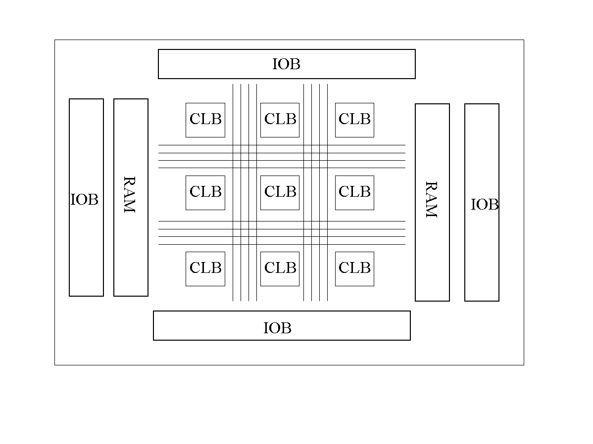
FPGAs
Re-configurable arrays of logic cells
Programmable logic functions
Flexible routing
On-chip memory

Slide 5
Handel-C
High level language to FPGA system
C-like syntax
Extensions for parallelism
    unsigned int 5 a,b;
    par {
    a = 10;
    b = 20;
    }
Predictable timing semantics

Slide 6
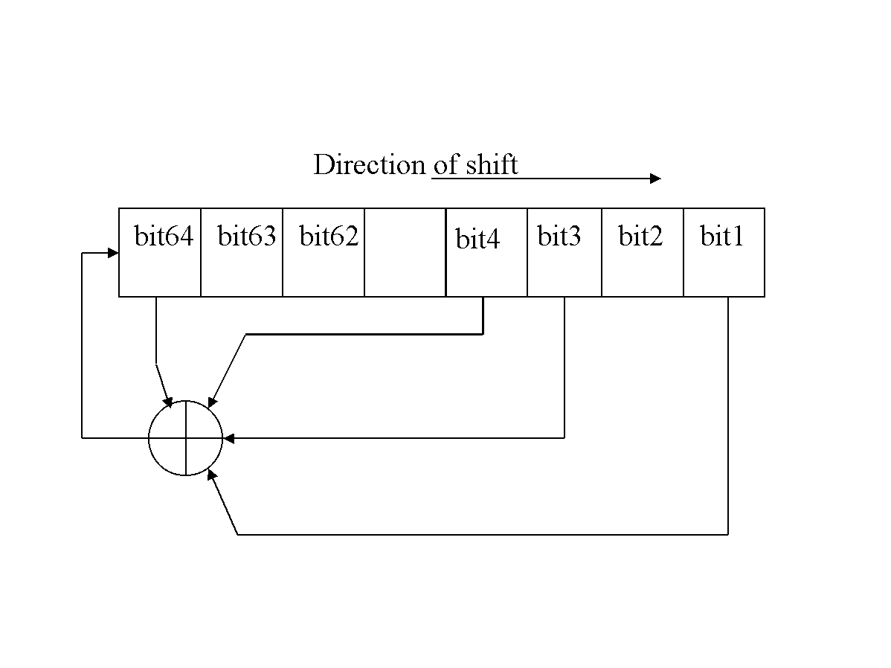
Random Number Generators
Linear Feedback shift register
Cellular Automata
True random sequences
Multiplicative/additive generators
Non-random sequences

Slide 7
Results - Diehard

Slide 8
Results - GP

Slide 9
Summary
Original single LFSR not optimal
Multiple LFSRs or CAs are better
Multiply & divide operators slow
True random source slow
  for seeding

Slide 10
Summary
Above a threshold no improvement in GP
  agrees with Meysenburg & Foster
Non-random sequences work!
Role of RNG in GP?
Future work
  Combine true RNG with PRNG

